Slide 1
Forecasting Prompt-Week and Front-Month Gasoline and Distillates Demand with SARIMAX Time Series Modeling for Accurate Supply and Demand Predictions
Dylan Fei

Slide 2


Background and Education
Rising sophomore (Class of 2028) at Columbia College, Columbia University, studying Applied Math (Computer Science and Economics focus)
Spent the last 8 weeks with Tian, Laura, and Joy on the Oil Analytics team
Fun Fact: I was admitted to college as a Chemistry and Creative Writing major
Dylan Fei

Slide 3
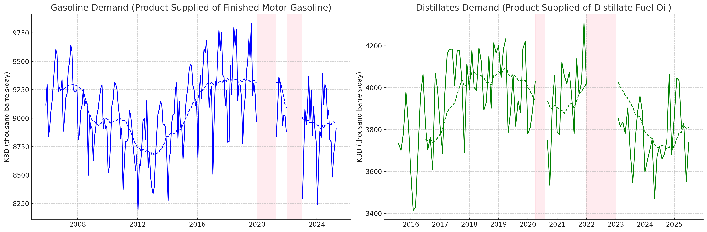
Overview and Motivation: Gasoline and Distillate Demand Forecasting
WoW Value of Gasoline (RBOB) and Diesel (HO) derivatives contracts dictated by respective changes in Supply and Demand.
EIA defines Demand using the simplified supply-side identity:
Demand = Domestic Production + Net Imports − Weekly Inventory Change
Quick Results: Gasoline forecasts were accurate to ~150 KBD (thousand barrels per day), a 0.46% weekly margin of error relative to 230 million barrels in typical stocks.
Distillate forecasts were accurate to ~180 KBD, with a 1.26% margin of error relative to 100 million barrels in typical stocks.
1

Slide 4
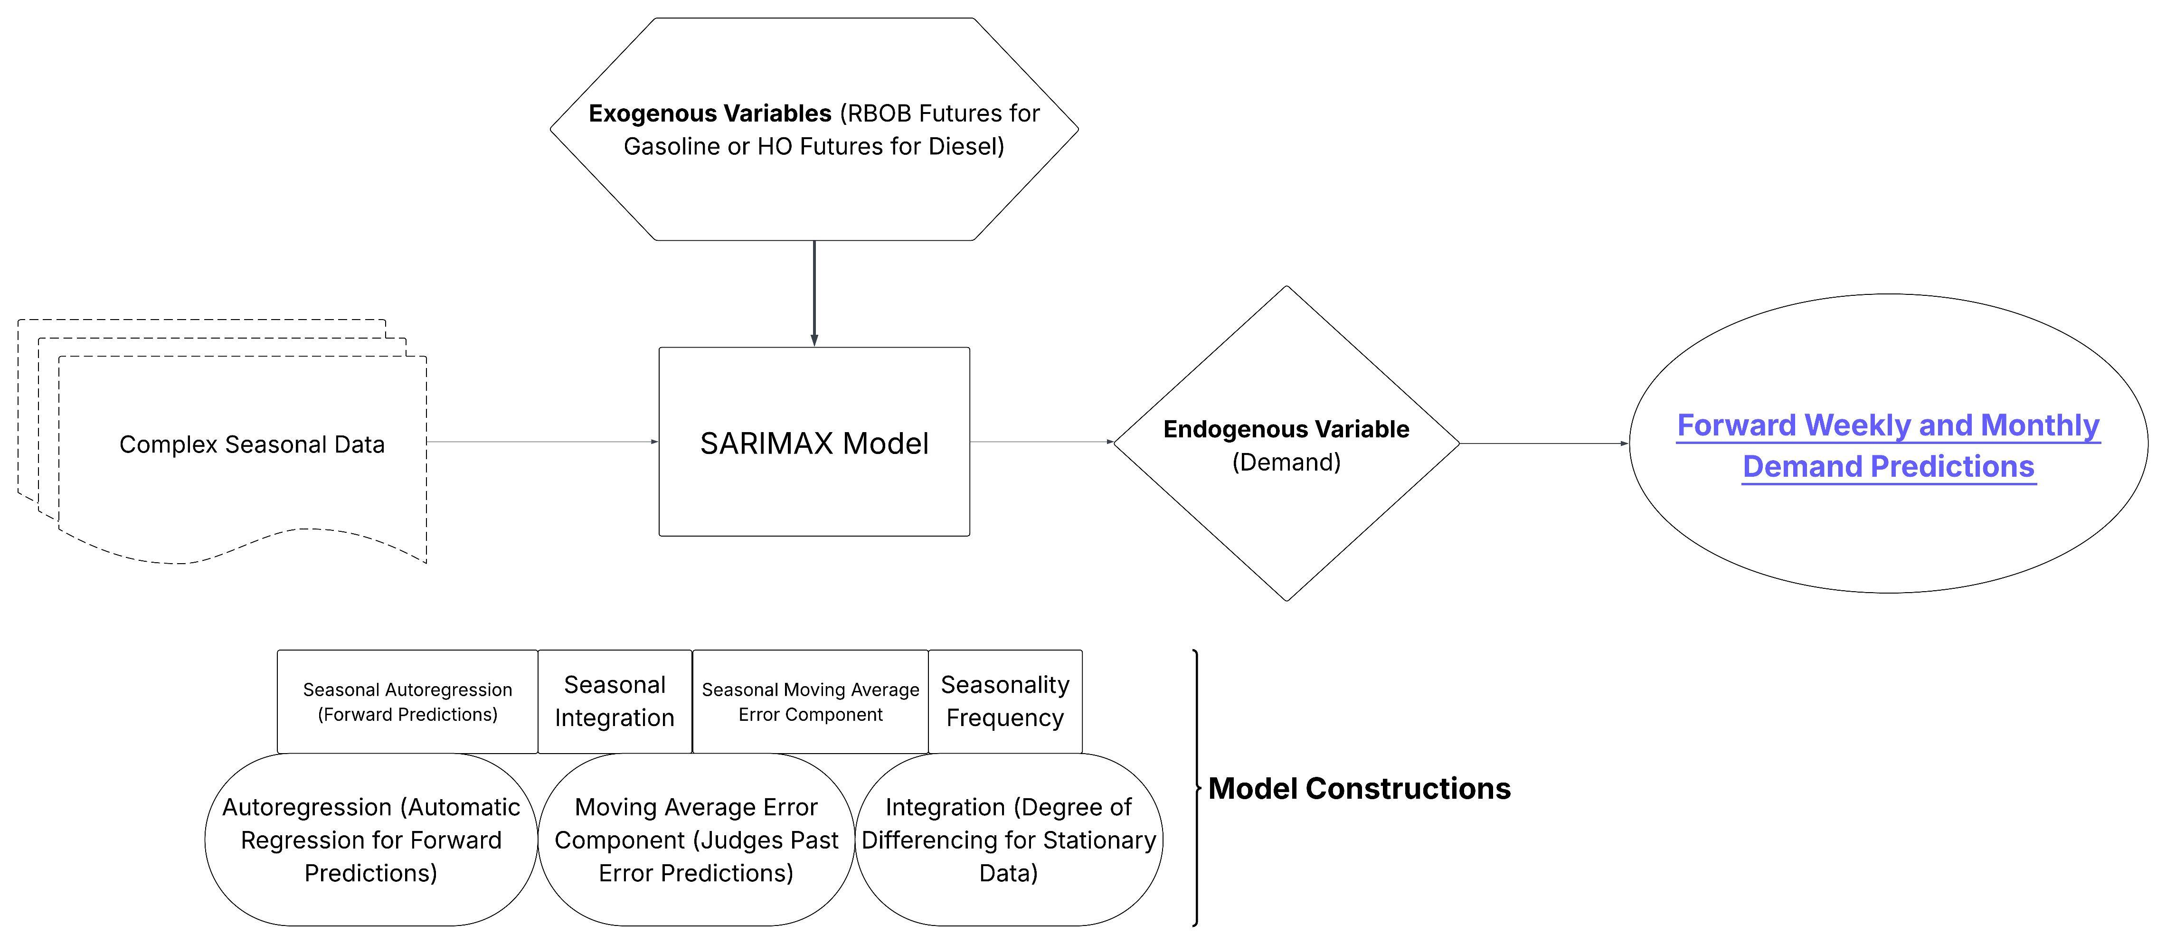
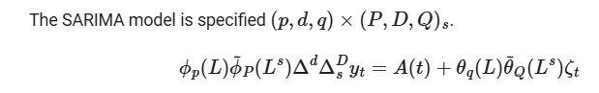
Time Series Model Architecture
A Seasonal Autoregressive Integrated Moving Average with Exogenous Variables (SARIMAX) model was chosen over
machine learning–based Extreme Gradient Boosting (XGBoost)
and Kalman filter–integrated Bayesian Structural Time Series model.
Imports for Model construction done through Python module statsmodels.tsa.statespace.sarimax.
2

Slide 5
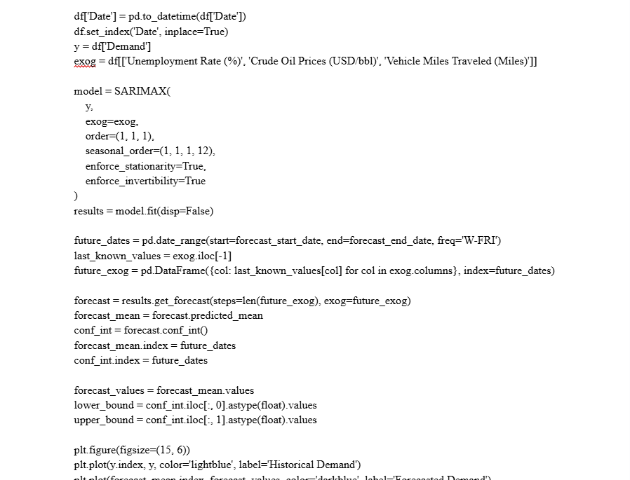
Sample Code Snippet

Slide 6
Gasoline

Slide 7
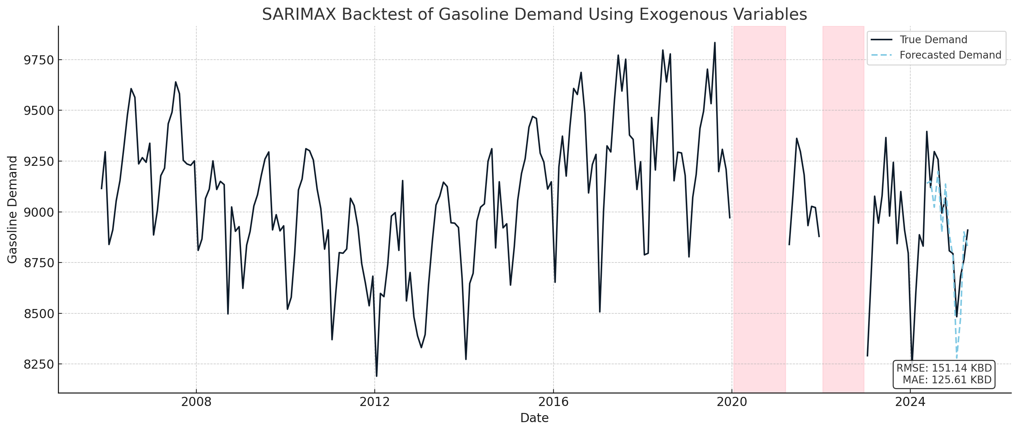
SARIMAX Model Preparation for Gasoline Demand Forecasting
Extracted 210 values for Gasoline Demand (EIA Product Supplied: Finished Motor Gasoline), using exogenous variables: lagged RBOB XB1 futures, Unemployment Rate, and Vehicle Miles Traveled.
Excluded outliers from Jan 2020–Mar 2021 and all of 2022 due to macroeconomic disruptions.
Performed a 12-month backtest to validate monthly forecasting accuracy.
Average error: ~125 KBD (<0.5% error); RMSE: ~150 KBD, capturing volatility from extreme deviations.
3

Slide 8
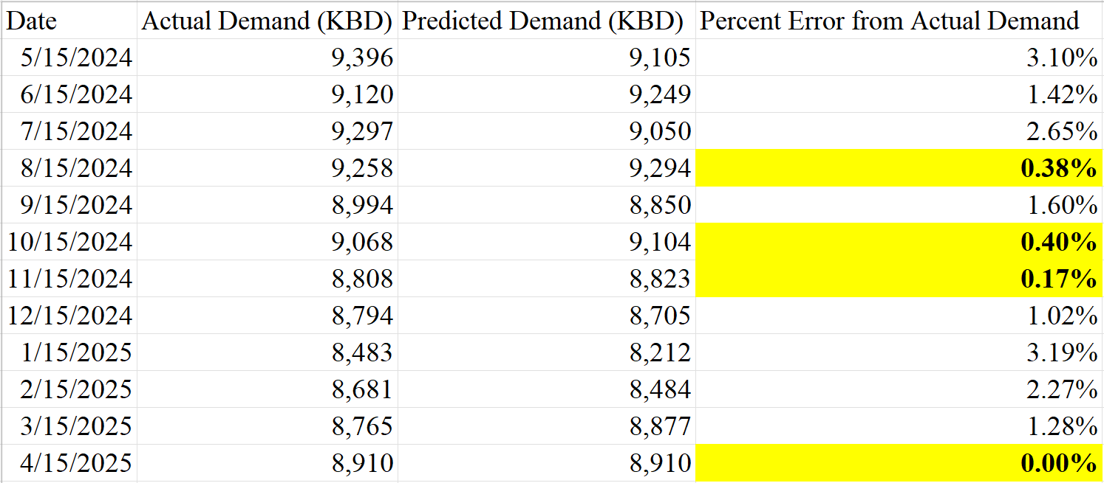
Model Assumptions and Results for Gasoline Demand Forecasting
Exogenous Variables (external factors with no feedback influence) chosen based on high correlation with Demand.
Unemployment Rate – A smooth, macroeconomic indicator inversely correlated with Gasoline Demand.
RBOB (XB1) Futures Prices – Reflect seasonal trends that strongly inversely align with shifts in Gasoline Demand.
Vehicle Miles Traveled (VMT) – A direct, though noisier, proxy to Gasoline Demand, capturing real-time driving activity.
4

Slide 9
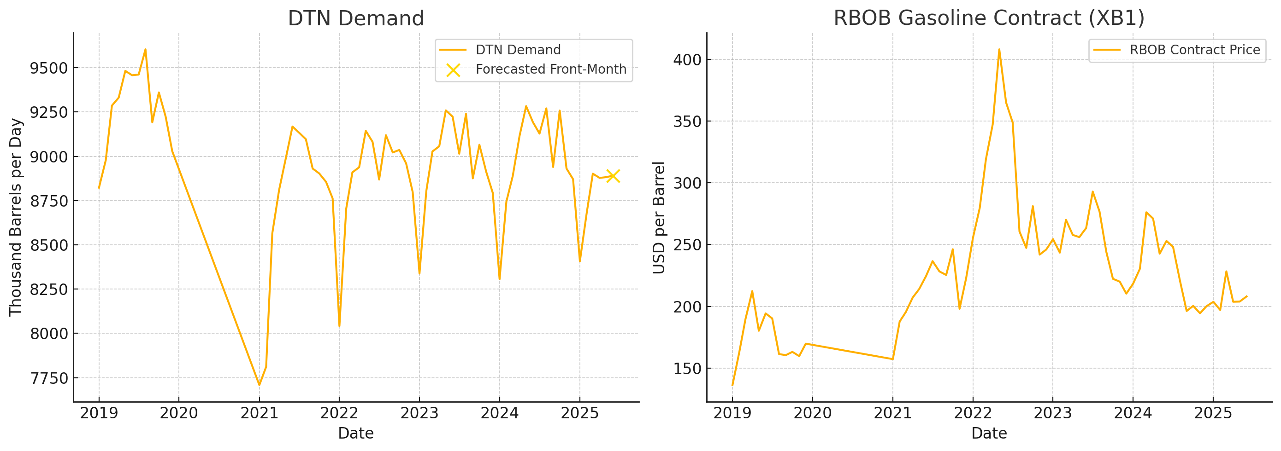
DTN Separate Forecasting as Supplementary Data Value to Gasoline Demand Forecast
Applied a separate SARIMAX forecasting model with DTN data grouped into a Monthly time series to generate the front-month value (additional data point for Gasoline Demand model) to a general error of <35 KBD.
DTN Gasoline Rack data offers an edge to predicting incoming EIA weekly data.
EIA data coming out on any given Wednesday reflects the Gasoline Demand ranging from last Thursday to two Fridays ago.
For data coming through on 7/9/2025 --> EIA measures Motor Gasoline Supplied from 6/27/2025 to 7/3/2025.
Grouped using bottom-up (PADD-level) approach. Data was first normalized and cleaned with PADD Coverage values and normalization values obtained from regression.
GASOLINE

Slide 10
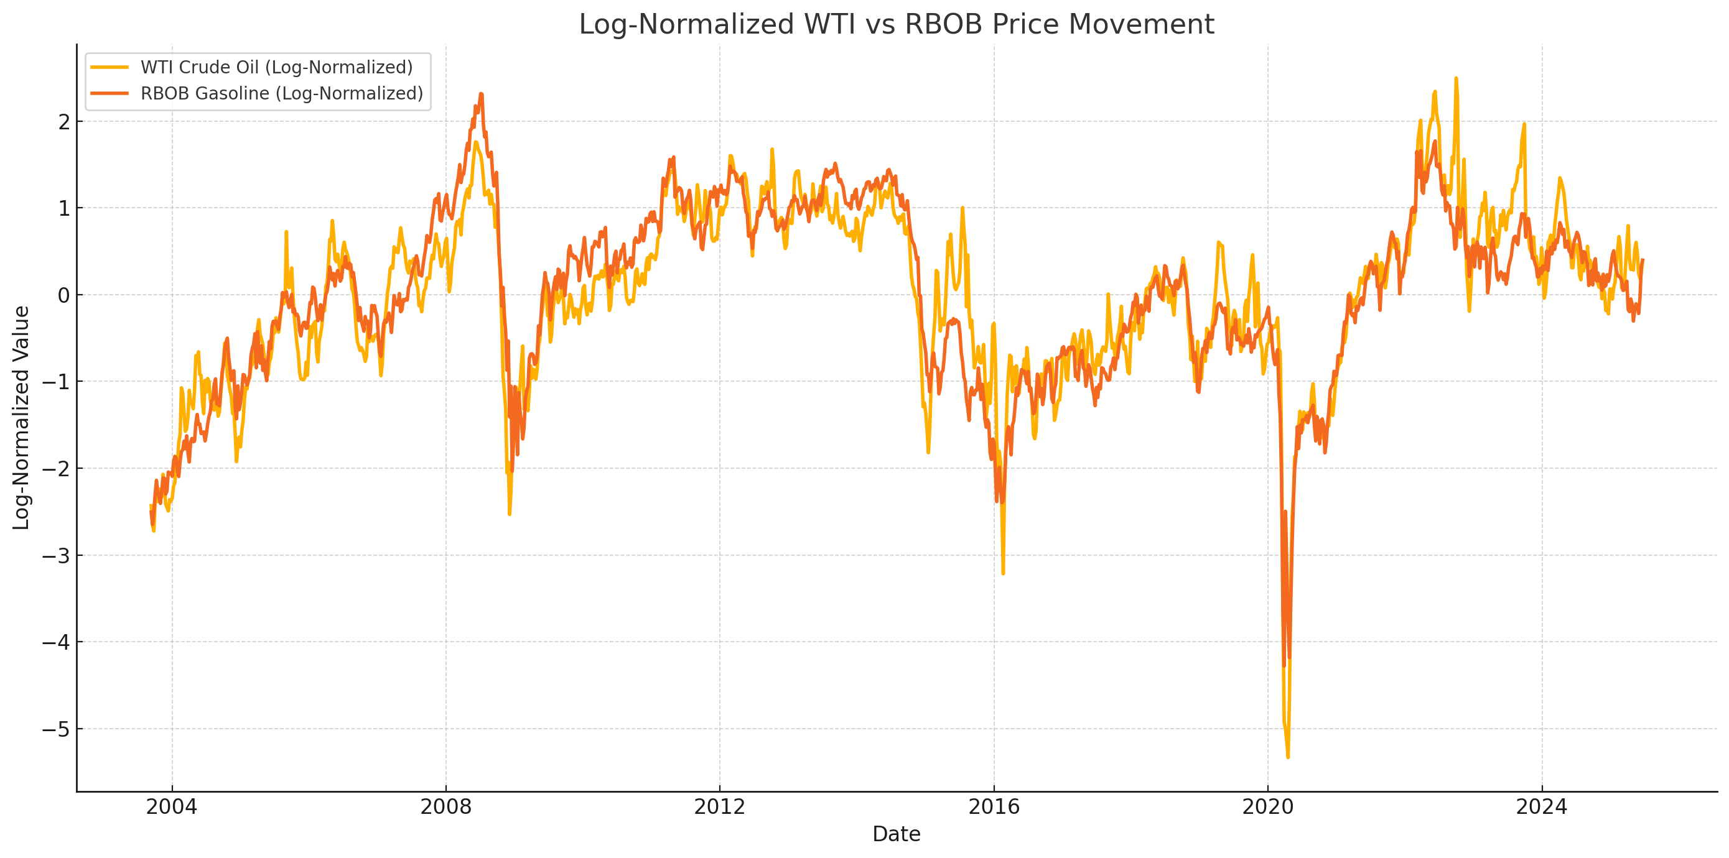

Slide 11
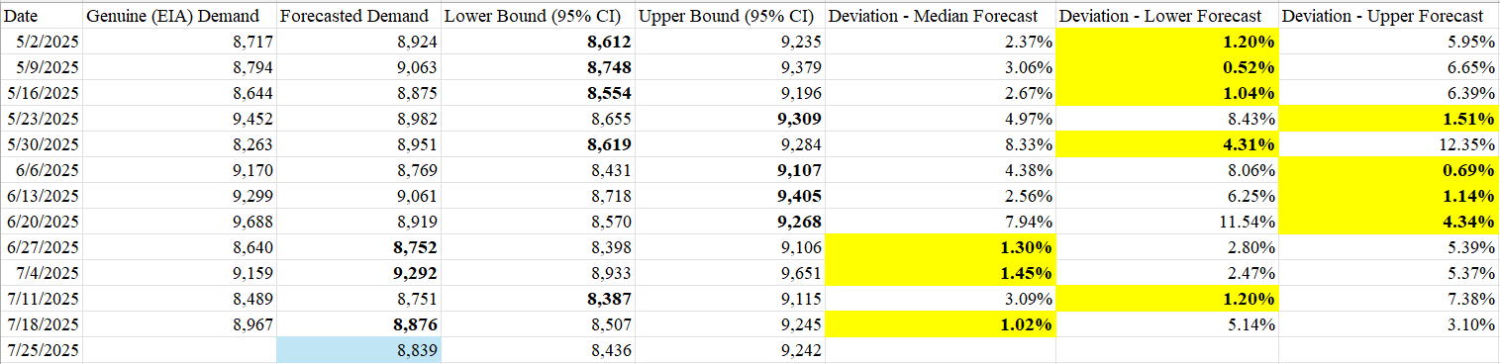
Prompt-Week Demand Predictions with Gasoline Demand
Predictions (Weekly Interpolations) made from May 2 to July 25 using Monthly EIA values until April.
Selection of Prompt-Week Forecasted Gasoline Demand will be based on a qualitative approach using DTN Rack Lifting Data as such:
If WoW DTN shows an abnormal decrease (>5% ↓), use the Lower Confidence Interval value.
If WoW DTN shows an abnormal increase (>5% ↑), use the Upper Confidence Interval value.
Otherwise, use the Median Forecasted Demand (“Forecasted Demand”).
5

Slide 12
Distillates

Slide 13
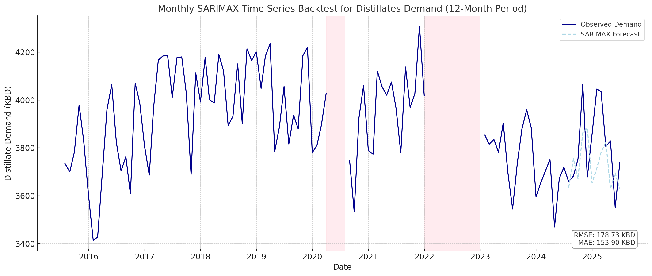
Prompt-Week and Far-Week Speculation with Distillates Demand
Sampled Monthly EIA data for Distillate Fuel Oil Product Supplied, removing Outliers from [2020, April 2021] and [2022].
Forecasting leveraged two categories of exogenous variables:
Agricultural Indices from projected acreage of key crops, capturing diesel demand from farm activity.
Lagged Heating Oil (HO1) Futures, included as a broader macro signal complementing agriculturally driven indicators.
6

Slide 14
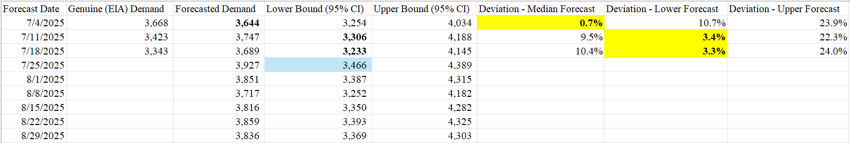
Application of SARIMAX Modeling for Distillates Demand
Weekly Distillate Demand is interpolated using the same methodology applied to Gasoline Demand forecasts.
Selection of Prompt-Week Forecasted Gasoline Demand will be based on a qualitative approach using DTN Rack Lifting Data as such:
If WoW DTN shows an abnormal decrease (>5% ↓), use the Lower Confidence Interval value.
If WoW DTN shows an abnormal increase (>5% ↑), use the Upper Confidence Interval value.
Otherwise, use the Median Forecasted Demand (“Forecasted Demand”).
7

Slide 15
Takeaways from the Role of Mathematical Finance in Commodities
Powerful Parameters: Adapted an advanced generative time-series model (SARIMAX) for forecasting Highly Volatile Gasoline and Diesel demand --> whittling down Weekly Demand Error relative to Weekly Stocks to <0.5% (Gasoline) and <1.3% (Diesel).
Logically Sound: Applied logical assumptions given research in historical market trends, while also cleaning away hidden outliers in data to allow for Sound Datasets for forecasting.
Easily Modifiable: Allows for near- and far-term speculation in Weekly and Monthly durations for both Gasoline and Distillate Demand.
Adjacent Benchmarking Models: Engineered Original Python scripts with other deterministic models in Machine Learning and Bayesian Statistics to benchmark SARIMAX Time Series performance with Gasoline and Diesel Demand.
8

Slide 16
Appreciation
Thank you Laura and Tian for the construction, as well as constructive feedback, that went into developing this project!
Also grateful for the feedback from a multitude of people (full time and interns) that went into developing this final presentation and Sarah for availing us this experience to learn from the best of the best in the industry.

Slide 17
Appendix
All code and datasets used can be found in this Git repository:
https://github.com/dfei16/FreepointSummerProject2025.git

Slide 18
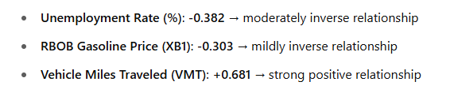
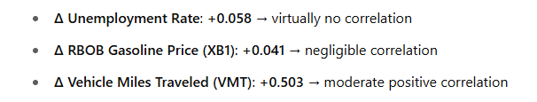
Gasoline Correlations

Slide 19
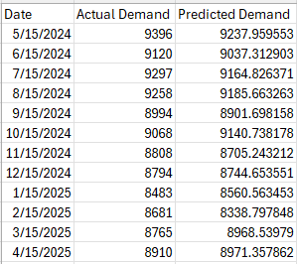
Continued - Values Predicted against Actual - 12 Months Backtesting

